Slide 1
Girlfriend’s new apartment
Capstone Project – IBM Data Science course

Slide 2
São Paulo Real Estate
The pandemic has caused several changes to our society.
One of the effects in the city of São Paulo was a sharp increase in the demand for rental properties
During the third trimester of 2020, there was an 18% increase in the number of searches in a popular real state website compared to the same period in 2019.
The number of officialized real state transactions was 336,968, a 37% increase compared to 10 years prior.
Our goal is to aid our client in her search for a new apartment.

Slide 3
Data sources – Quinto Andar
Quinto Andar is one of the most famous real state websites in São Paulo.
We filter for apartments that comply with the followin requirements given by the client:
Total rental price (Rent + condominium fee + taxes) larger than 1000,00 BRL and lower than 2800,00 BRL.
Total number of bedrooms larger than 2.
Number of parking spots larger than 1.
Close to train or metro stations.
Accepts pets.
Currently available.

Slide 4
Data sources – Foursquare
Foursquare is an app, which is purpose is to clients discover and share information about businesses and attractions around designated locations.
We obtained data on the venues surrounding each of the remaining apartments after filtering.
Area of 800 m around each apartment.
Only the venues categories are stored.
This data is used for clustering apartements.

Slide 5
Data sources - Google Maps
Similar to other large cities in the world, São Paulo has problems with traffic.
We use Google Maps "Distance Matrix" API to calculate the transit time using public transportation from each apartment.
The time is calculating considering an arrival time of 9 am the next Monday to the time the code is run.
For this presentation July 26, 2021.

Slide 6
Methodology
First step – Filtering
Done during data acquisition.
Clustering:
K-Means of the apartments given the frequency of categories of venues surrouding each apartment.
Test locations are used to choose the number of clusters and the chosen cluster.
Transit time filtering
Filter the apartments within 60 minutes comute time.

Slide 7
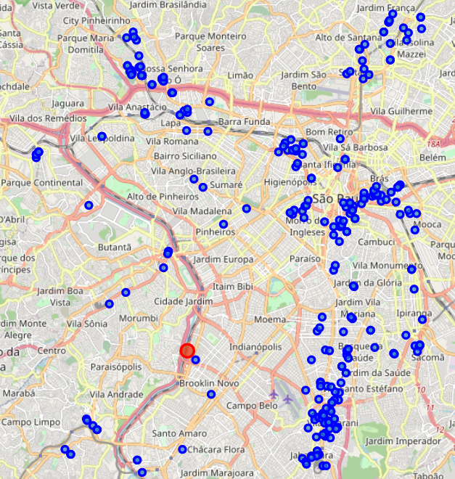
Results – Total apartments Map

Slide 8
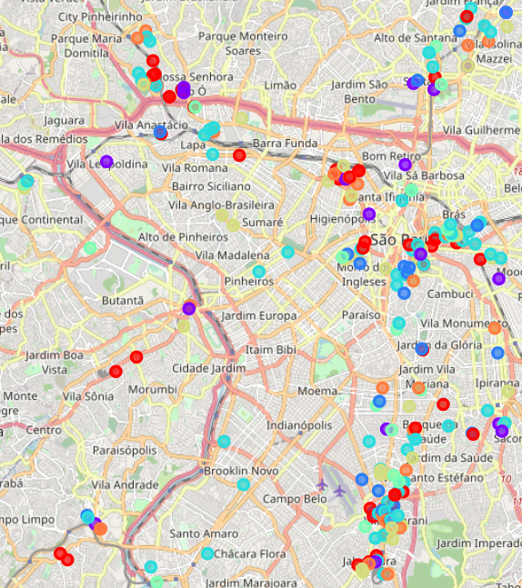
Results – Map after clustering

Slide 9
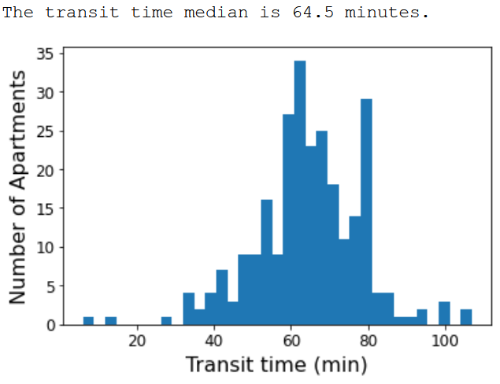
Results – Transit time histogram

Slide 10
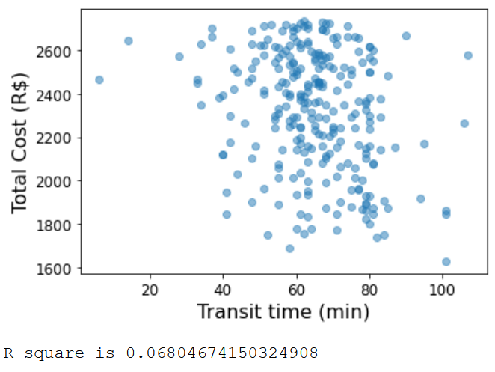
Results – Transit time vs Total cost scatter plot

Slide 11
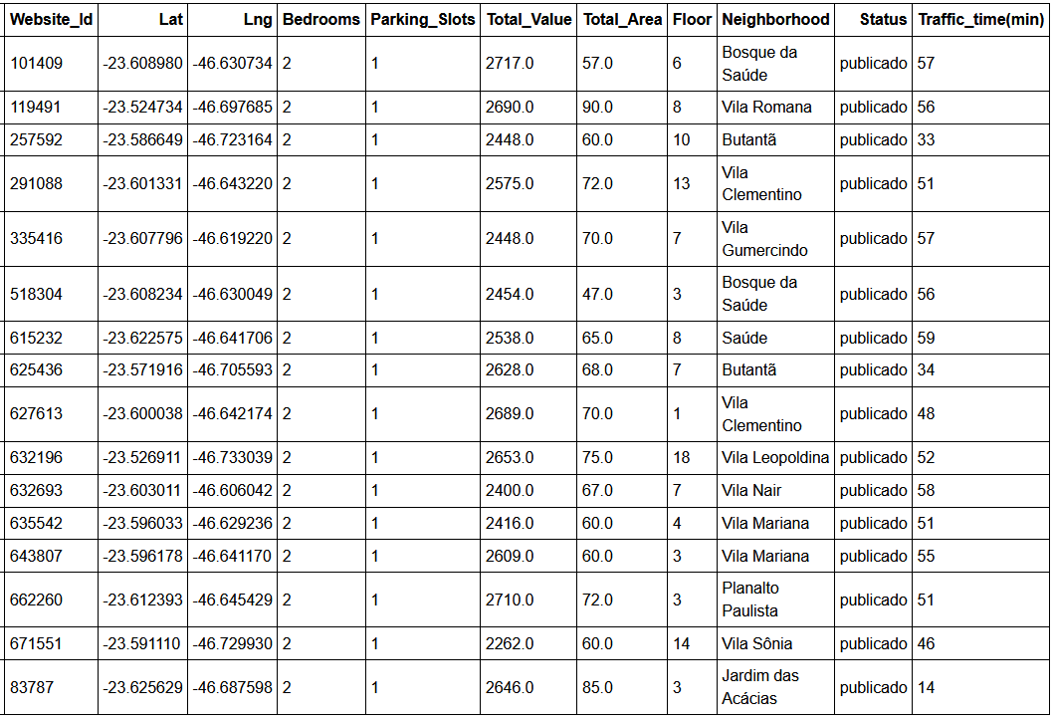
Results – Chosen Candidates

Slide 12
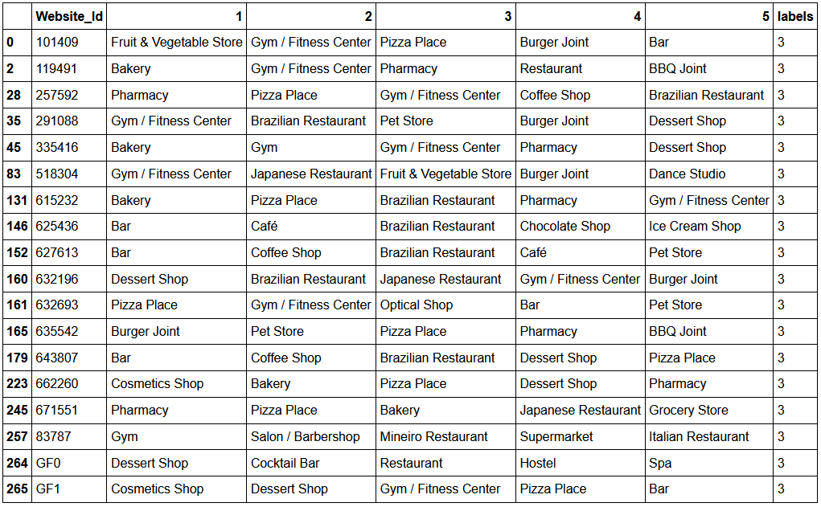
Results – Chosen Candidates top 5

Slide 13
Conclusion
From over 4200 apartments the algorithm resulted in 16 candidates
All of the requirements were met
The candidates in the same cluster clearly share the same characteristics.
Transit times of 60 minutes
The final decision on the optimal apartment will be made by the client's preferences.

